Slide 1
BODY IMAGE
Learning objectives
Learning outcomes
We are learning about how social media can influence and affect perceptions about body image and cause stress.
By the end of the lesson you will be able to…
Recognise the impact of social media on body image
Know who to ask for advice and where to look for guidance on body image and online stress
Use techniques for minimising stress that may arise from a negative perception of our body image influenced by social media.
KEY
VOCABULARY
Social media, selfie, body image, healthy, ‘likes’, body confidence, editing, celebrities, filters, followers, attention, comments

Slide 2
BODY IMAGE
IN A DIGITAL WORLD
Some questions to think about…
What do we mean by ‘body image’?
How is that different to what a person’s actual body looks like?
What makes people think they need to look a certain way?
How does the media influence this?
How does gaining ‘likes’ and followers on social media make people feel?
Why is this important to some people?
Give reasons why you think social media, especially selfies, can lead to stress and anxiety?
Helen talks body image
Notes:
Ask students to create a mind map using the questions above. You can decide whether this is carried out in silence upon entrance as a thinking activity and baseline assessment, or whether students are to discuss their answers in pairs, or share as a whole class.
A mind map enables students to capture words, ideas and responses to a question or topic. Ask students to organise their responses into branched groups that are linked by the theme, and to indicate relationships and connections on their maps. If required, you can create a template to help students get started or draw an example on the board.
Optional: show the video at https://bcove.video/3cecH5l In small groups, students watch the ‘Body Image and You!’ film either on their phones or a school device, depending on your school’s phone policy and facilities available. After sharing their reactions to the film, students discuss how they think the internet, particularly social media, can cause stress and impact on a young person’s body image - however only do this if time permits or if you feel this is more appropriate than a mind map.

Slide 3
BODY IMAGE
SELF ASSESSMENT
A. How confident are you about knowing the pressures relating to selfies?
B. How confident are you about knowing the pressures relating to body image?
C. How confident are you about knowing where to find support with body image?
0
10
NOT CONFIDENT
EXTREMELY CONFIDENT
Notes:
Students should answer the three baseline questions on a confidence scale: 0 = not confident, 10 = extremely confident.

Slide 4
BODY IMAGE
BEHIND THE SELFIE
A
B
C
Mohammed is trying to take the perfect selfie to post online. He feels really pressured to only post a picture he looks good in.
Jack follows Mohammed. He thinks Mohammed’s pictures always look much better than his, and Mohammed’s large number of followers makes him feel down about himself.
Ava is Mohammed’s friend and rates his selfie 3/10 as a joke. Other people start to copy her and add hurtful comments, so he deletes the selfie.
What are their THOUGHTS?
What are their FEELINGS?
What are their ACTIONS?
Notes:
You can conduct this activity individually or in pairs if this is more suitable for your classroom environment.
Provide A3/A4 paper for the activity. This part of the activity may require class discussion if students are struggling to think of someone’s thoughts, feelings, or actions. It may be preferable to place students in mixed ability groups rather than facilitating yourself in order to encourage as much student-led work as possible.

Slide 5
BODY IMAGE
BEHIND THE SELFIE
ALL
What might be going through each character’s mind?
What feelings and emotions could they be experiencing?
How might their body image and body confidence be affected by their experiences online?
Being healthy is more important than what makeup or hair styles are trending on social media. Why is that?
FURTHER CHALLENGE
Is someone’s online profile an accurate description of who they really are?
How far will some people go to create the perfect selfie?
Any new ideas? Add them to your diagram.
Notes:
These questions have been differentiated to help facilitate progression through the activity. However, you can choose only the questions that would be appropriate for your students.

Slide 6
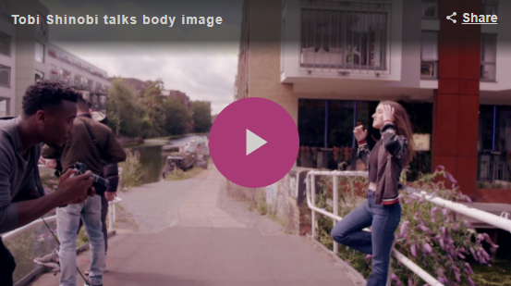
BODY IMAGE
BEING OURSELVES
What are some useful tips and advice for someone struggling with body image?
Toni Shinobi talks body image
Notes:
Show the video at https://bcove.video/30nnKDQ
This video can be watched individually on devices, or if this is not possible you can play it from a projector at the front of the class.
Students should consider any tips and advice that they think would be useful and write them down on a post-it note. Be on hand to answer students’ questions if needed.

Slide 7
BODY IMAGE
BEING OURSELVES
ALL
How can we reduce the stress and anxiety around body image that social media might cause?
How can we celebrate our differences, rather than wanting to conform and look a certain way?
How can we feel comfortable and confident in who we are?
How can we make sure we are healthy?
How can we change or influence the conversations we have with our friends about body image, into something that’s more honest and helpful?
Where can we go for help or guidance if we need to?
FURTHER CHALLENGE
How can we use social media to take pride in looking healthy and like our unique selves?
What advice would you give someone who cares so much about poses, clothes, makeup and filters that it is impacting their day-to-day life?
Notes:
Questions to aid discussion have been differentiated to enable effective conversation and progress through the lesson.
Create a ‘wall of ideas’ for dealing with body image and online stress using the sticky notes students have created. You can give them time to add ideas from the questions discussed above, as well as what they have found on the on the Every Mind Matters website. The word wall can be discussed as a whole class, and if time permits the sticky notes could be streamlined to the top five best tips for advice.
Optional Extension activity: What is beauty? Distribute photos of celebrities or famous people, either from magazines or online sources. In their pairs, students should discuss how they think the media impacts on our body image, for example, when Instagram stars Photoshop their images to make them appear ‘perfect’. How does this affect our perception of how we should look?

Slide 8
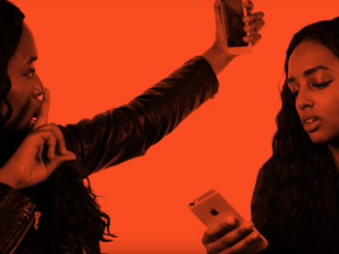
BODY IMAGE
PLENARY: CLASS PLEDGE
Create a pledge, slogan or hashtag to adopt as a class
I understand that I don’t need to use filters when I post my selfies. I’m fine the way I am.
Difference is good
#beyourselfie #selfieesteem
Notes:
Other options for plenary:
Create a ‘board blast’ with all the slogans and hashtags
Create a poster to display as a class manifesto or set themselves challenges, e.g.: ‘I will only take 15 selfies this week’, ‘I will step away from my phone for an hour every day’, etc.
Before the end of class, remind students about the importance of asking for help if they need it, and encourage them to visit the Every Mind Matters website (https://www.nhs.uk/oneyou/every-mind-matters/youth-mental-health/) in their own time, along with other helpful websites and sources of information.

Slide 9
BODY IMAGE
SELF ASSESSMENT
A. How confident are you about knowing the pressures relating to selfies?
B. How confident are you about knowing the pressures relating to body image?
C. How confident are you about knowing where to find support with body image?
0
10
NOT CONFIDENT
EXTREMELY CONFIDENT
Notes:
Ask students to think back to the confidence line that they shared at the start of the session and consider the same questions.

