Slide 1
We hope you find the information on our website and resources useful. This resource contains links to external websites. Please be aware that the inclusion of any link in this resource should not be taken as an endorsement of any kind by Twinkl of the linked website or any association with its operators. You should also be aware that we have no control over the availability of the linked pages. If the link is not working, please let us know by contacting TwinklCares and we will try to fix it although we can assume no responsibility if this is the case. We are not responsible for the content of external sites.
This resource also contains potentially sensitive and/or upsetting topics that may emotionally impact on students you use it with due to their experiences in their past. It is your responsibility to consider whether it is appropriate to use this resource with your students. If you do use this resource, it is your responsibility to ensure that appropriate support is available for anyone affected.

Slide 3
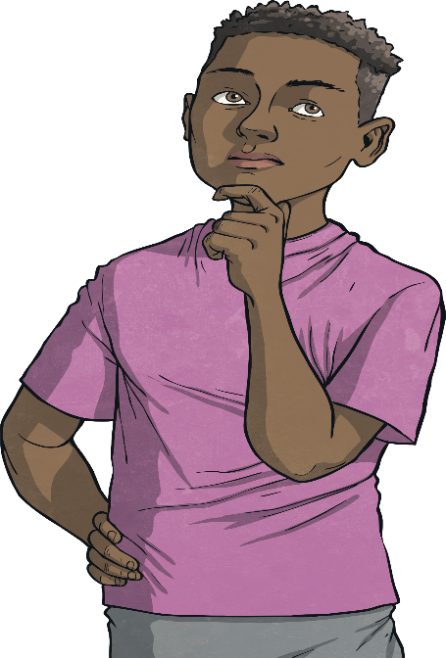
Railways
Lots of children find trains fascinating but there are many dangers and some of those dangers are invisible.
Can you think of any reasons why railways or trains could be dangerous?
Talk to a partner about your ideas.

Slide 4
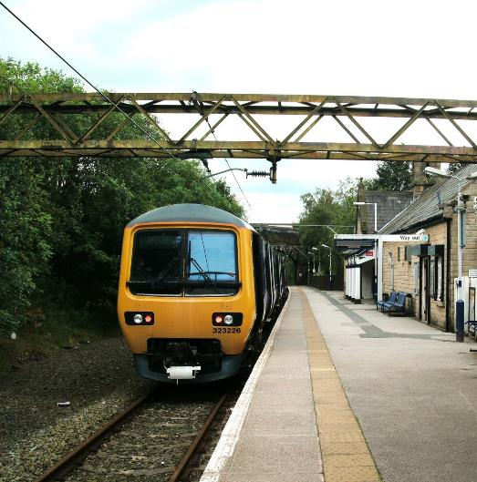
Electric Railways
More and more railways are becoming electrified. Electric railways allow a quieter and more reliable service and are better for the environment.
However, increased electric lines above railways means potentially more danger. The trains are powered by electricity carried through overhead power lines or a conductor rail, sometimes called the third rail.
Did You Know…?
The electric current that powers the railway is 100 times stronger than the current that powers your home.
“Electric train in Hadfield station” by [Raymond Knapman] is licensed under CC BY-SA 2.0

Slide 5
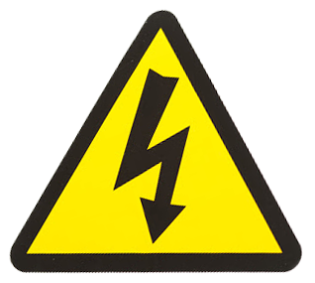
Danger
Overhead power lines and conductor rails (through which the electric current passes) are never switched off. That means it is never safe to touch them.
You can also be electrocuted even if you don’t touch the lines; if you fly or dangle things from bridges near the power lines, you can be electrocuted too.
Electric cables run under the ground and beside the track of railway lines too.
Look out for the electricity danger warning sign.
Did You Know…?
Electricity moves at the speed of light and can arc or jump up to three metres.

Slide 6
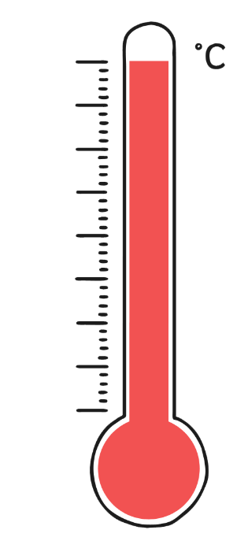
Danger
The temperature of an exposed overhead power line can reach up to 5,000˚C.
5000
4000
3000
9 out of 10 people die from being electrocuted by getting too close to overhead power lines, rather than direct contact.
2000
1000
0
-1000
-2000
Even if the railway is not electrified, never play on or near it; you are putting your life in danger.
-3000

Slide 7
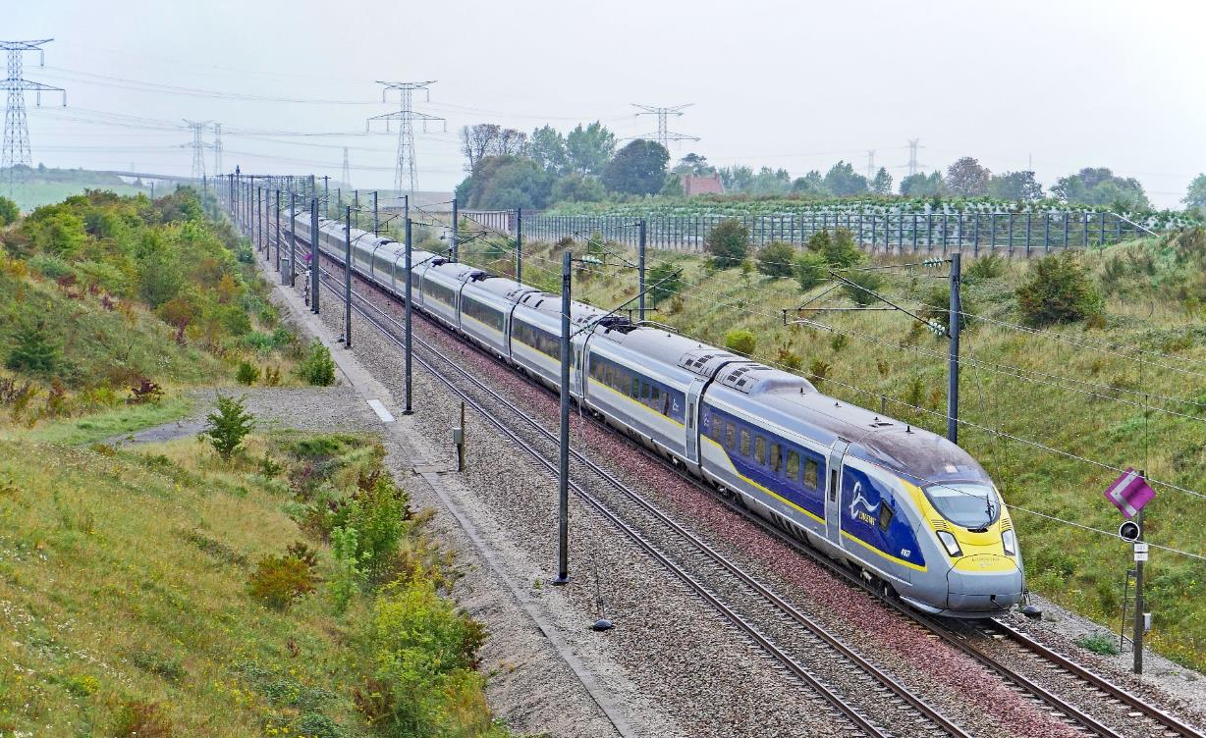
Electric Trains: Dangers
Overhead power lines
Underground power cables
Conductor rails (sometimes called third rails)

Slide 8
Level Crossings
When using a level crossing, look out for these warnings:
If the barriers are closed, an alarm sounds or the lights are flashing red, this means that a train is approaching.
Do not attempt to cross the line. Every year, people are killed crossing when they shouldn’t.
Once the train has passed, you must wait for the red lights and the alarm to stop, before you cross.
Always walk; don’t run.
If you are on a bicycle, get off and push it.
Did You Know…?
Trains travel the length of 20 football pitches before they stop, so they often cannot break in time, even if they see a person on the track.

Slide 9
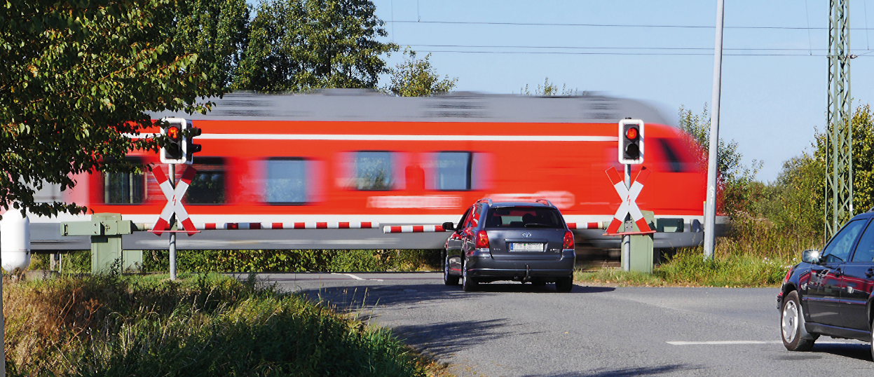
Did You Know…?
It is against the law to trespass on a railway line and trespassers can be fined up to £1,000.

Slide 10
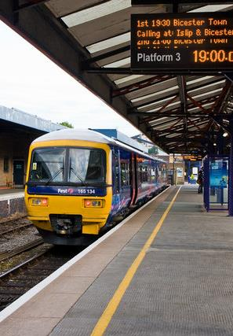
Train Travel
When waiting for a train, stand behind the yellow lines on the station platform. Trains can travel very fast and not all trains stop at every station. The wind current caused by passing trains can be very strong.
If you drop something onto the track, do not attempt to go onto the track to get it; let a member of railway staff know.
There is sometimes a large gap between the train and the platform. Take extra care when getting on and off the train.
Never try to stop a train door from closing by putting your hand between the doors.
“Oxford Station (Platform 3)” by [Martin Addison] is licensed under CC BY-SA 2.0

Slide 11
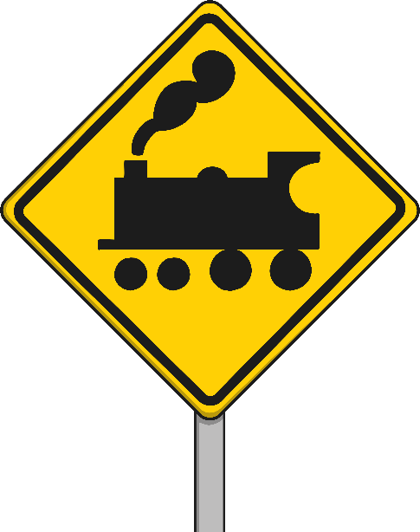
Stay Safe
Follow these rules to stay safe around the railway:
Never step onto the tracks. If you drop something, leave it.
Never touch overhead power cables.
Never dangle or fly anything from a bridge.
If you need to cross the track, use a level crossing.
Be aware of railway signs and warnings.
Always stand behind the yellow line when waiting for a train.
Mind the gap between the train and the platform.

