Slide 1
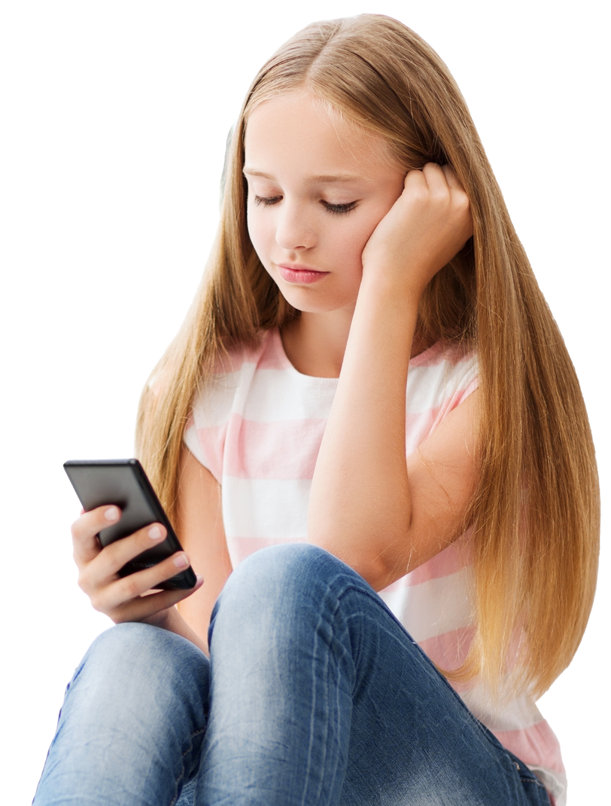
Bullying and cyberbullying

Slide 2

Overview
Pupils explore the meaning and impact of bullying and cyberbullying. Pupils will learn what they can do if they see or hear anyone being bullied and how to deal with this situation appropriately. Pupils will also find out how they can get help with bullying.
Recommended age group
Education providers for ages 10-11 (Year 6)
Time
60 minutes approximately
Preparation
Before delivering the lesson:
familiarise yourself with the safeguarding policy and procedure should a pupil choose to make a disclosure following the lesson
read through the classroom tips on slide 4
consider cross-curricular links
print out slides 10,11,12 (optional - a larger print out may be required for pupils who may struggle to read a small font on the board)
Resources
PowerPoint presentation
blank A4 paper and pencils, colouring pencils or pens
Key vocabulary
Bullying behaviour (teasing someone because of how they look or who they are or something they have done, getting others to join in to make fun of someone), cyberbullying (bullying online or through social media), emotions (feelings), support (help), communication (talking/listening)
Follow up
You may wish to extend pupils’ learning with one of the extended learning projects on slide 24.
Visit www.childline.org.uk/info-advice for further reading for teachers, parents or carers on bullying.
Notes:
Teacher Only
Bullying and cyberbullying is a very important topic and should be embedded into a wider PSHE curriculum as well as being taught within this session.
Curriculum links
PSHE curriculum
KS2 Programme of Study Pupils learn:
Core theme 1: Health and Wellbeing
H20. strategies to respond to feelings, including intense or conflicting feelings; how to manage and respond to feelings appropriately and proportionately in different situations
H42. about the importance of keeping personal information private; strategies for keeping safe online, including how to manage requests for personal information or images of themselves and others; what to do if frightened or worried by something seen or read online and how to report concerns, inappropriate content and contact
Core theme 2: Relationships
R18. to recognise if a friendship (online or offline) is making them feel unsafe or uncomfortable; how to manage this and ask for support if necessary
R19. about the impact of bullying, including offline and online, and the consequences of hurtful behaviour
R20. strategies to respond to hurtful behaviour experienced or witnessed, offline and online (including teasing, name-calling, bullying, trolling, harassment or the deliberate excluding of others); how to report concerns and get support
R21. about discrimination: what it means and how to challenge it
R22. about privacy and personal boundaries; what is appropriate in friendships and wider relationships (including online)
R23. about why someone may behave differently online, including pretending to be someone they are not; strategies for recognising risks, harmful content and contact; how to report concerns
R30. that personal behaviour can affect other people; to recognise and model respectful behaviour online
Core theme 3: Living in the wider world
L11. recognise ways in which the internet and social media can be used both positively and negatively
L15. recognise things appropriate to share and things that should not be shared on social media; rules surrounding distribution of images
Relationships Education and Health Education statutory guidance
“…the curriculum on relationships and on sex should complement, and be supported by, the school’s wider policies on behaviour, inclusion, respect for equality and diversity, bullying and safeguarding…”
By the end of primary school pupils should know…
Respectful relationships
about different types of bullying (including cyberbullying), the impact of bullying, responsibilities of bystanders (primarily reporting bullying to an adult) and how to get help
Online relationships
that the same principles apply to online relationships as to face-to-face relationships, including the importance of respect for others online including when we are anonymous
the rules and principles for keeping safe online, how to recognise risks, harmful content and contact, and how to report them
Mental wellbeing
that bullying (including cyberbullying) has a negative and often lasting impact on mental wellbeing
Internet safety and harms
that the internet can also be a negative place where online abuse, trolling, bullying and harassment can take place, which can have a negative impact on mental health
how to consider the effect of their online actions on others and know how to recognise and display respectful behaviour online and the importance of keeping personal information private

Slide 3
Teacher support
How to deal with bullying at school
Check that pupils are aware of the school bullying policies and that you are aware of how to handle any disclosures during or following the lesson.
Tell pupils that if they are being bullied at school, they should tell a friend, a teacher, or their parents or carers. It’s less likely to stop unless they do.
It can be hard to do this, so if they don’t feel they can do it in person it might be easier to write a note to their parents explaining how they feel.
Or perhaps they could confide in someone outside the immediate family, like a grandparent, aunt, uncle or cousin and ask them to help tell their parents what is going on.
Their form tutor also needs to know what is going on, so they should try to find a time to tell him or her when it won’t be noticeable. They could stay behind on the pretext of needing help with some work.
If they don’t feel they can do that, they could speak to the school nurse.
They shouldn’t be tempted to respond to any bullying or hit back because they could get hurt or get into trouble
Signposting
Pupils are encouraged to speak to family, friends, a healthcare professional, school nurse or a member of staff in their school if they require support and/or guidance with the issues associated with bullying/cyberbullying. For further information please visit the Every Mind Matters website and Childline, The Mix and Shout 85258, the free, confidential, 24/7 text messaging support service for anyone who is struggling to cope. If any pupils are struggling with their mental health as a result of bullying, you can signpost them to your local NHS helpline.
Core message
Building resilience is very important for all young people. Nobody has the right to bully anyone. Whether you’re being bullied by your friends, family, other people at school or even strangers, it’s never ok. There are ways to stop it. Start by talking to someone you trust as soon as possible.
Information
Bullying can be defined as intentional harmful behaviours carried out repeatedly over time, against an individual with less physical or psychological strength, who cannot defend themselves. There are broadly four types of bullying: physical, verbal, relational and online.
Cyberbullying can take the form of many behaviours including:
harmful messages (text, instant, email)
impersonating another person online
sharing private messages
uploading or forwarding photographs or videos of another person that leads to shame and embarrassment
creating hate websites/social media pages
excluding people from online groups.
Notes:
Teacher Only

Slide 4
Classroom tips
Climate for learning
Read through Guidance for Learning in a Safe Environment.
This includes advice on:
developing and revisiting effective ground rules drawn up with pupils
familiarity with your school’s safeguarding policy and procedures, including Child Protection and other relevant policies
being prepared in case pupils make a disclosure
including and protecting vulnerable pupils
using distancing techniques so that pupils can discuss sensitive issues without being encouraged to make a disclosure
handling sensitive questions
involving pupils with special educational needs and disabilities (SEND) and/or autism
You may also wish to familiarise yourself with any schemes or offers available in your school, organisation or local area to support young people who are experiencing bullying or cyberbullying. Consider making links to the school’s current bullying policy and any events that take place to tackle bullying such as anti-bullying week.
Anonymous question box
Place a question box or envelope somewhere in the classroom.
Pupils write down any questions that occur to them during the lesson and submit them anonymously. You can address these questions in the next lesson.
Identify pupils for whom this topic may be challenging
Children and young people with experience of bullying, harassment or cyberbullying may find this topic challenging. It is important to be aware of these pupils before teaching this lesson and of any sensitivities or issues that may come up. Consider briefing or debriefing the lesson with any pupils who might be affected by this topic.
Notes:
Teacher Only

Slide 5
The impact of Covid-19
Preparation
Returning to school and managing the changes that have come about because of Covid-19 will have posed many different challenges for young people. It will have affected every young person differently and it will be more important than ever before for pupils to have a safe space to explore their feelings and experience.
There is clear guidance for teaching sensitive issues in the Guidance for Learning in a Safe Environment document and it is important that this is read before delivering this lesson.
Adapting lessons to social distancing
If you're maintaining bubbles or following social distancing, you could use the following ideas.
Where pair or small group discussions aren’t possible, replace with personal reflections or individual contributions to whole class discussions
Please refer to the Government guidelines and your own school’s advice
Virtual delivery ideas
Activity 1 (Slide 9-10): Thoughts, feelings, actions
This activity suggests completing in pairs and/or small groups however pupils can be given plain paper and instructed to individually draw a head, heart and a hand. Pupils can place the numbers around their own pictures individually then feedback answers as a class.
Activity 2 (Slides 11-18): What’s the story?
This activity suggests completing in pairs/small groups however pupils can answer discussion questions and multiple choice questions individually by printing out the slides or writing on paper or using mini-whiteboards, then feedback answers as a class.
Activity 3 (Slide 19-20): Circles of support
The discussion questions on slide 20 suggest completing in pairs/small groups however pupils can undertake individually on paper, then feedback answers as a class.
Notes:
Teacher Only

Slide 6

How would you know?
Looking unhappy
Finding it hard to focus
Acting nervous
Being quiet
Not wanting to be in school
Skipping meals
Feeling unwell – tummy aches, headaches, etc.
Messing around in class
Spending more time alone
Changing friendship groups
Becoming upset easily
Notes:
Lesson stimulus (3-4 mins)
Show pupils different signs of bullying/cyberbullying. Ask pupils to decide which ones they think a person who is being bullied might experience.
Ask pupils to discuss their choices and feedback as a class; explain statements are all signs that someone could be experiencing bullying.

Slide 7

What are we learning?
Key vocabulary
bullying behaviour (teasing someone because of how they look or who they
are or something they have done, getting others to join in to make fun of someone)
cyberbullying (bullying online
or through social media)
emotions (feelings)
support (help)
communication (talking/listening)
Learning outcomes
We will be able to…
identify the meaning of bullying and cyberbullying and describe the impact it can have on a person
explore how young people can deal with bullying and cyberbullying safely
explain how to find support and advice on bullying and cyberbullying.
Learning objective
We are learning what bullying and cyberbullying is and how we can support people being bullied.
Notes:
Learning objective & outcomes (2-3 mins)
Briefly share the learning objectives, outcomes and key vocabulary with pupils. For key vocabulary, note that easier-to-understand alternative words are provided in the brackets.

Slide 8
How confident are you in…
10
Extremely confident
9
8
7
6
knowing the meaning and impact of bullying and cyberbullying?
understanding safe ways to deal with bullying and cyberbullying?
finding support and advice on bullying and cyberbullying?
5
4
3
2
1
0
Not confident
Notes:
Baseline assessment: How do you feel? (3-4 mins)
Show pupils the three statements and ask them to rate their confidence in each using a scale from 0-10.
There are lots of ways you might do this activity. Pupils could respond to the statements individually by writing their three numbers down on paper, or verbally by discussing their feelings in pairs/groups. Alternatively, you could ask pupils to reflect silently, before holding up the relevant number of fingers in response to each statement.
How confident are you in:
knowing the meaning and impact of bullying and cyberbullying?
understanding safe ways to deal with bullying and cyberbullying?
finding support and advice on bullying and cyberbullying?
Use this initial assessment to decide whether you might need to adapt the lesson content to extend or support pupils, depending on their starting point.

Slide 9

What does bullying and cyberbullying mean?
Behaviour that hurts someone else’s body and/or feelings and is repeated rather than a one off.
Behaviour that hurts someone else online through social networks, gaming and mobile phones, and is repeated rather than a one off.
Notes:
Activity 1: Thoughts, feelings and actions (10 mins, slides 9-10)
Show pupils two definitions: one for bullying and one for cyberbullying and ask them to identify which is which.
Behaviour that hurts someone else’s body and/or feelings, and is repeated rather than a one off. This is bullying.
Behaviour that hurts someone else online through social networks, gaming and mobile phones, and is repeated rather than a one off. This is cyberbullying.
Allow thinking time here for pupils and encourage them to ask questions about the definitions, or guide classroom discussion:
What do you think are the main differences between bullying and cyberbullying?
How are bullying and cyberbullying similar?
Ask pupils to think about how a person might feel, think, and act if they are being bullied/online bullied.
Feedback ideas verbally as a class or draw pictures/write words to express ideas.
Pupils may have misconceptions around how a person might feel, think or act if they are being bullied, such as people will always feel sad or lonely. However, summarise to young people that thoughts and feelings change all the time, and this can impact our behaviour – which can also change.

Slide 10

Thoughts, feelings and actions
Sad
Finding it hard to complete work in school
No one likes me
Not talking to other people
Angry
I am a bad person
Lonely
Being hurtful to other people
Embarrassed
Misbehaving
I am the only one being bullied
Why me?
Thoughts
Feelings
Actions
Notes:
Activity 1: Thoughts, feelings and actions (10 mins), continued
In pairs/small groups ask pupils to match up the statements and pictures and explain their choices. Alternatively, pupils could draw their own table and write the numbers which correspond to the statements either on paper or whiteboards.
Pictures:
Head – Thoughts
Heart – Feelings
Person running – Actions
Statements:
Sad
Finding it hard to complete work in school
No one likes me
Not talking to other people
Angry
I am a bad person
Lonely
Being hurtful to other people
Embarrassed
Misbehaving
I am the only one being bullied
Why me?
Feedback answers: Thoughts (3, 6, 11, 12), Feelings (1, 5, 7, 9), Actions (2, 4, 8, 10). Communicate to pupils that some people may have struggled with matching the pictures to the statements and this is ok, the discussions they will have had around the task will have been helpful to their learning.
Highlight to pupils that the thoughts and feelings young people face are valid but can change over time.
Subsequently, summarise to pupils that sometimes people can experience very intense emotions, which when negative can be upsetting and isolating. This can make people feel as though there is something ‘wrong’ with them, no one else feels how they do and therefore they can find it hard to tell people about being bullied. There are however people everywhere who have similar experiences and understand what it is like to be bullied. Talking about what is happening is a powerful tool to help empower young people.
Encourage pupils to have a think about any further questions they might have about this task.

Slide 11

What’s the story?
Alex arrives at their lesson and the two pupils who sit opposite them whisper to each other and stare. The teacher asks Alex a question and when Alex gets the answer wrong some members of the class start to laugh.
During lunchtime Alex sits alone and eats their school dinner, however, they cannot find their drinks bottle - it disappeared when going to the toilet - so they end up feeling thirsty for the rest of the day.
The afternoon arrives and the class are doing a maths lesson; a pupil keeps using Alex’s ruler without asking, making it hard for Alex to complete the work so Alex just gives up.
Notes:
Activity 2: What’s the story? (20 mins, slides 11-18)
Read out this short story about Alex’s day at school.

Slide 12

What’s the story?
After school Alex walks home and receives a phone message from an unknown number saying, “looking for this?” Underneath the message there is a photograph of Alex’s drinks bottle in the bin at school.
Alex walks through the door and mumbles, “School was fine” to both parents and heads upstairs to play on the computer. Alex starts an online game but stops when people from school join and start talking about the lost water bottle, so Alex turns off the computer and tries to go to sleep, but finds it hard because they can’t stop thinking about school the next day.
Notes:
Activity 2: What’s the story? (20 mins), continued
Read out this short story about Alex’s day at school.

Slide 13

Discussion questions
Where in the story did Alex experience bullying?
Where in the story did Alex experience cyberbullying?
Is there any action that Alex could have taken?
What could other pupils in Alex’s class have done differently?
What could Alex’s friends do to support them?
Notes:
Activity 2: What’s the story? (20 mins), continued
Ask pupils to work in pairs or small groups to discuss the questions.
Feedback answers to the discussion questions as a class.
Explain to pupils that there are ways to deal with bullying/cyberbullying safely. Explain to pupils that they will complete a multiple-choice quiz to see if they understand how best this can be achieved.

Slide 14
Quiz question 1
Nav sees a friend at school get pushed in the playground…
What could Nav do?
Tell other pupils in school
Tell a member of staff in school
Tell the police
Notes:
Activity 2: What’s the story? (20 mins), continued
Read the multiple-choice question and the three possible answers to the class. Instruct pupils to answer the question individually using mini-whiteboards, paper, or use hands (One hand = A, Two hands = B, Hands on head = C) to show their answers. Provide the answer and discuss any class feedback, then move onto the next question.
Quiz Question 1: What could Nav do?
Nav sees a friend at school get pushed in the playground…
Tell other pupils in school
Tell a member of staff in school
Tell the police
Potential answers and important key messaging:
b. Explain to pupils that it is important to report physical bullying to a member of staff, so that the person who is being bullied can be supported and the school can try and stop bullying taking place in the future. Let pupils know that they can tell any trusted adult.

Slide 15
Quiz question 2
A pupil in school has been sending Sam nasty pictures
and messages to their phone for the last 6 months…
What could Sam do?
Explain the situation to a trusted adult or friend
Report the situation to the school who could support
telling the police
Both of the above
Notes:
Activity 2: What’s the story? (20 mins), continued
Quiz Question 2: What could Sam do?
A pupil in school has been sending Sam nasty pictures and messages to their phone for the last 6 months…
Explain the situation to a trusted adult or friend
Report the situation to the school who could support telling the police
Both of the above
Potential answers and important key messaging:
c. Both of the above. Explain to pupils that it is important to report ongoing cyberbullying to a trusted adult or friend so that the person being bullied can be supported. It would also be a good idea to let the school know so they can try and prevent this behaviour happening in the first place. It is also important to get advice from a trusted adult and/or school staff member about whether the police need to be informed, as the bully/bullies might be committing a crime.

Slide 16
Quiz question 3
One of Mo’s friends doesn’t want to invite another friend
to their birthday party…
What could Mo do?
Speak to a trusted adult
Speak to a staff member at school
Speak to the friends involved
Notes:
Activity 2: What’s the story? (20 mins), continued
Quiz Question 3: What could Mo do?
One of Mo’s friends doesn’t want to invite another friend to their birthday party…
Speak to a trusted adult
Speak to a staff member at school
Speak to the friends involved
Potential answers and important key messaging:
c. Explain to pupils that all friendship groups experience challenging situations, and sometimes people can behave poorly or hurt somebody's feelings on purpose or accidentally as a one off. This may not be bullying, it may be that someone just made a mistake, and the friends might be able to solve the problem by talking to each other. However, if someone is consistently left out on purpose over and over again, then a trusted adult should be told, as this is bullying.

Slide 17
Quiz question 4
Someone asks Charlie to send everyone they know a picture of their friend looking silly…
What could Charlie do?
Tell them no
Ask them why they want the picture
Send the picture straight away
Notes:
Activity 2: What’s the story? (20 mins), continued
Quiz Question 4: What could Charlie do?
Someone asks Charlie to send everyone they know a picture of their friend looking silly…
Tell them no
Ask them why they want the picture
Send the picture straight away
Potential answers and important key messaging:
a or b, but not c. Explain to pupils that sharing photos or information (including contact details) about someone without their permission is not ok as it could hurt someone’s feelings or make them feel uncomfortable. To avoid cyberbullying you should always ask the person in the picture if they are ok with it being sent to someone else.

Slide 18
Quiz question 5
Someone at school says they are being bullied on social media but asks Amal not to tell anyone…
What could Amal do?
Tell them they will not keep this secret, it is too important, but will support them in telling family and/or the school
Tell a member of staff in school without telling them
Tell another friend in the same class about the situation and ask for their advice
Notes:
Activity 2: What’s the story? (20 mins), continued
Quiz Question 5: What could Amal do?
Someone at school says they are being bullied on social media but asks Amal not to tell anyone…
Tell them they will not keep this secret, it is too important, but will support them in telling family and/or the school
Tell a member of staff in school without telling them
Tell another friend in the same class about the situation and ask for their advice
Potential answers and important key messaging:
a, maybe b depending on how serious the situation, not c. Explain to pupils that sometimes, keeping promises is important to friendships, however if someone is being bullied it is very important that an adult knows so they can provide support and try and stop the bullying. Telling other pupils about a friend that is being bullied might seem like a good idea if you want advice, however sometimes it can make the bullying worse. It is better to speak directly to the person being bullied, a parent/carer or trusted adult in school.
Before moving on, ask pupils if they have any questions about the scenarios discussed in the quiz or any other content that has been covered in activity 2.

Slide 19
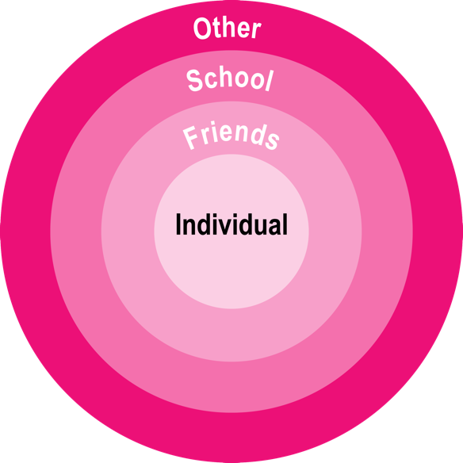
Circles of support
Seeking support from others:
Asking for help
Find out where to get more support in school
Speak with family and friends
Speak to a trusted adult such as a teacher or doctor
Report incidents to the police
Learn online from websites
Find out information from books
and podcasts
Supporting yourself:
Spend time with friends and family
Join clubs or sports teams
Meet new people
Do activities that you enjoy – painting, dancing, singing…etc.
Take time out to relax – have a bath, listen to music, sleep more...etc.
Use passwords and privacy settings on social media to keep your information safe
Notes:
Activity 3: Circles of support (10 mins, slides 19-20)
Show class the two support lists. Explain to pupils that there are lots of different places you can get support and advice about bullying, and for people who are being bullied – they are not alone! Sharing information with trusted adults at home or in school is suggested, such as teachers, parents and older family members. In addition to seeking support from others, there are also things young people can do in their everyday lives to make themselves feel good and build their self-esteem, so that bullying does not change how they view themselves.
Encourage pupils to ask questions, or facilitate whole class discussion about different types of support, such as:
Who is the best person to talk to in school about bullying?
How do you know if someone feels supported/unsupported?
Ask pupils to pick one piece of advice from each list and explain how it could support a young person such as Alex or another pupil explored in the session today. Pupils can undertake task in pairs if additional support is required.

Slide 20

Discussion questions
How can we try and stop bullying and cyberbullying?
Why do you think stopping bullying and cyberbullying can be difficult?
What can someone do if they bully someone and feel bad about it?
Who at school should you speak to if you experience any type of bullying?
Notes:
Activity 3: Circles of support (10 mins), continued
Ask pupils to work in pairs or small groups to discuss the following questions. Feedback answers as a whole class.
How can we try and stop bullying and cyberbullying?
Explain to pupils that trying to stop bullying is everyone’s responsibility: schools need to teach young people about it, parents/carers should find out more information about it to support young people, pupils should report bullying as well as learn to be kind to one another and apologise when they make mistakes.
Why do you think stopping bullying and cyberbullying can be difficult?
Explain to pupils that stopping bullying can be difficult as people can feel scared, alone and worried that they might make it worse. With cyberbullying, sometimes people are not sure who is bullying them and are unsure how to stop it. Remember that with all types of bullying there are people who can help and you are not the only person to go through this experience. Bullying can be stopped.
What can someone do if they bully someone and feel bad about it?
Explain to pupils that everyone makes mistakes and how we behave afterwards shows us who we really are. If you hurt somebody else on purpose or by mistake, start by apologising to the person and trying to communicate with each other. If you feel like you need support with this, speak to a trusted adult to help you through this process.
Who at school should you speak to if you experience any type of bullying?
Inform pupils of the members of staff in school to whom they can report bullying or ask for guidance and support.

Slide 21
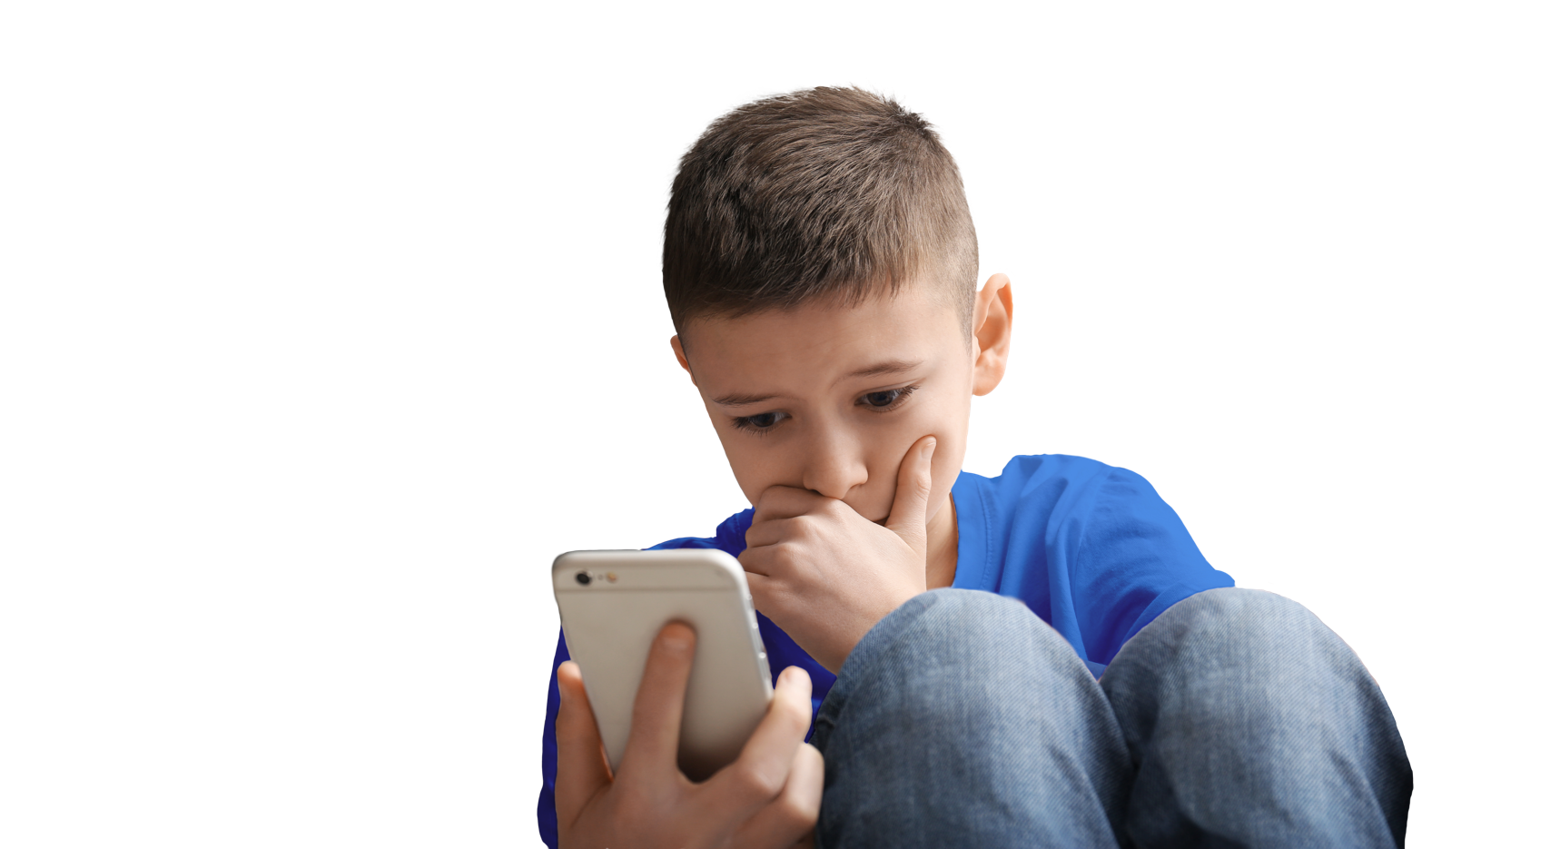
New messages
Tyler puts a message on social media saying:
“Everyone has something
to say about my life…
it is like no one even understands me!”
Notes:
Plenary: New messages (3 mins)
Present pupils with a short scenario. This task is an opportunity for pupils to apply their learning from the session to support a pupil, such as Tyler, who is being bullied; indicating what young people have learnt and what teaching is still required in subsequent sessions.
Invite pupils to ask questions about the scenario, or facilitate class discussion around the scenario, such as:
Why do you think Tyler decided to share this post on social media?
What emotions do you think Tyler is experiencing?
What could have made Tyler feel like this?
Ask pupils to think of different ways people could help Tyler move forward and show support. Encourage young people to share their ideas with the person next to them.
Remind pupils that many people can feel very lonely and isolated when they are being bullied and it is important that everyone understands there are always people to speak to about bullying: teachers, support assistants, parents and older family members (any trusted adult).

Slide 22
How confident are you in…
10
Extremely confident
9
8
7
6
knowing the meaning and impact of bullying and cyberbullying?
understanding safe ways to deal with bullying and cyberbullying?
finding support and advice on bullying and cyberbullying?
5
4
3
2
1
0
Not confident
Notes:
Assessment for learning (3-4 mins)
Show pupils the three statements from the initial assessment once more and ask pupils to rate their confidence in each now they have completed the lesson.
There are lots of ways you might do this activity. Pupils could respond to the statements individually by writing their three numbers down on paper, or verbally by discussing their feelings in pairs/groups. Alternatively, you could ask pupils to reflect silently, before holding up the relevant number of fingers in response to each statement.
It is an opportunity for pupils to reflect on what they have learned in the lesson. Ask pupils to consider why their scores have changed and give an example of something new they have learned or thought about.
How confident are you in:
knowing the meaning and impact of bullying and cyberbullying?
understanding safe ways to deal with bullying and cyberbullying?
finding support and advice on bullying and cyberbullying?

Slide 23

Reaching out
Remember to reach out to a trusted
adult or friends if you are experiencing bullying/cyberbullying or think someone else might be.
There are lots of organisations that
can give support:
Childline: www.childline.org.uk/info-advice
or call 0800 1111
Shout: Text 85258
Bullying UK: www.bullying.co.uk
Notes:
Signposting (1 min)
Unfortunately bullying does happen, but it’s never OK – remind pupils that they can reach out to teachers, support staff in school, family members or even the police if they are experiencing bullying or suspect that someone they know is being bullied – either in person or online. Let pupils know the importance of reporting bullying to prevent it happening, both online and in school.
Remind pupils that there are lots of organisations that can give support such as Childline, or the Mix, which run free telephone helplines for children and young people. Shout 85258 is a free, confidential, 24/7 text messaging support service for anyone who is struggling to cope.
NHS U&E 24/7 helplines: If any pupils are struggling with their mental health as a result of bullying, you can signpost them to your local NHS helpline at
https://www.nhs.uk/service-search/mental-health/find-an-urgent-mental-health-helpline

Slide 24
Extended learning projects
Awareness campaign: Pupils create school resources to raise awareness of bullying such as posters, banners and assembly presentations.
Bullying support poster: Pupils work with their families at home to create a poster about how to ask for support about bullying and key bits of advice. These can be hung up at home or brought into school.
Handy tips: Pupils draw round their hands and write five things that people can do to help support people experiencing bullying/cyberbullying.
Building better behaviours: Each pupil gives their top tip for dealing with bullying and it is written on an outline of a brick to create a class wall/house/school.
School anti-bullying policy: Pupils create
school rules to help stop bullying in all its forms.
Jar of hearts: On pieces of paper, pupils write down something nice about an anonymous member of their class, “This person is kind because…” and they are placed in a jar and can be read out in lessons or at the end of the week as a self-esteem/self-worth exercise to show appreciation and respect for each class member.
Anti-bullying week/event: Pupils design an
anti-bullying week campaign for their school.
Or plan an event to raise money for a pre-existing
anti-bullying charity.
Anonymous question box: Pupils write down any outstanding questions they have from the lesson or around the topic of bullying and cyberbullying. These can be addressed in a subsequent session or used to inform future learning.
Notes:
Extended learning projects
These can be given to pupils as projects to extend their learning, they could be done either in school or at home.

